Slide 1
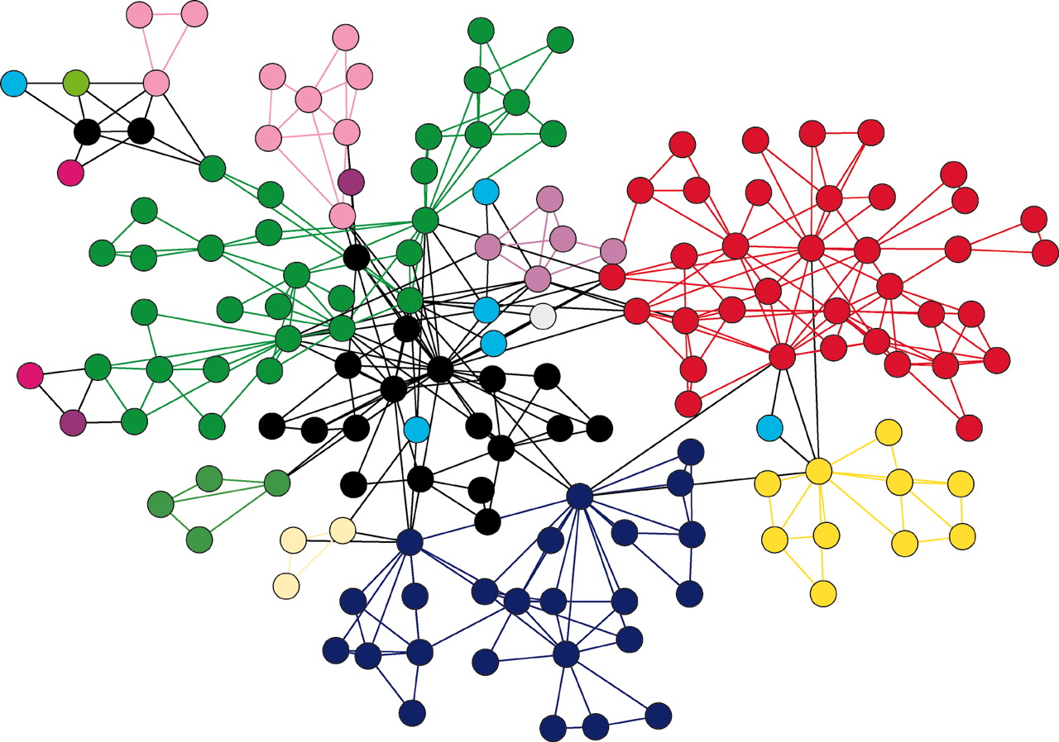
GRAPHS
(Data Structure)
Ms. P. V. Kharbuli, Computer Sc.

Slide 2
Graph Representation: Adjacency List
We define an adjacency list for each vertex
struct adjList{
int vertex;
struct adjList *next;
};
We will define a graph as a finite number of vertices and an array indices to represent numbered vertices upto some predefined MAX. Each array index represents a vertex and it holds the address of its adjacency list.
struct graph{
int noOfVertices;
adjList* adjVertex[MAX];
};

Slide 3
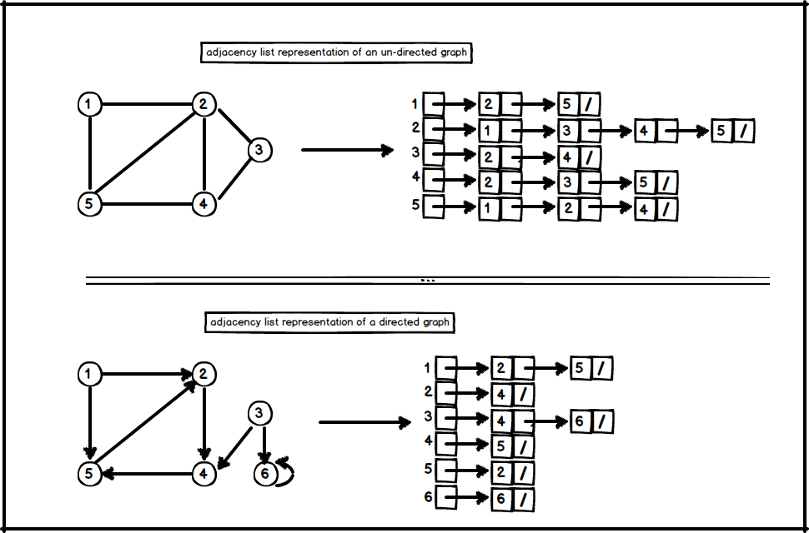
Graph Representation: Adjacency List

Slide 4
Building a graph: Algorithm
Steps
Define the adjacency list and graph structure
Declare a graph ‘g’ and adjList *start;
Ask the user for the number of nodes store it in ‘n’. Here nodes are labelled 0 – ‘n-1’.
Store ‘n’ in graph ‘g’ i.e. g.noOfVertices=n;
Create adjacency list for each vertex of the graph: for(i=0 to n-1)
  Inilialize start=NULL;
  Ask user to enter 1 if edge exits from vertex i to vertex j, else 0. Here j=every other vertex in ‘g’ i.e. j=i+1 to n
    If(user enters 1) then j is adjacent to i
      Create a node in a linked list with j as its value. This node is to be added as the last node of the list.
  g.adjVertex[i]=starting address of the list created;
End

Slide 5
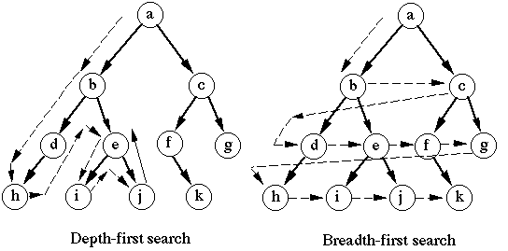
Graph Traversals

Slide 6
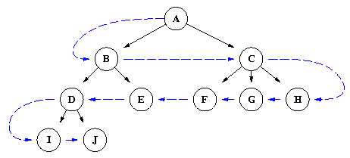
Breadth First Seach(BFS)
Definition:
We start with a node or first node, say A, then we examine the all the neighbours of A i.e B and C. Then we examine all the neighbours of the neighbours of A.
For given graph:
A, B, C, D, E, F, G, H, I, J
BFS Traversal
Edge

Slide 7
Breadth First Seach(BFS): Algorithm
Steps
Initialize ‘q’ to empty
Mark every vertex as not visited by initializing the elements of visited[i]=0 where ‘i’ ranges from 0 to n
Mark vertex ‘start’ as visited
Add vertex ‘start’ to the queue ‘q’
While(‘q’ is not empty)
  Delete the front vertex from ‘q’ and store it in ‘v’
  Print ‘v’
  Get the adjacent vertex of ‘v’ and store in ‘current’ i.e. current=g.adjVertex[v];
  Traverse this list till all adjacent vertices are visited
    If (‘current->vertex’ is not yet visited) then
      Mark ‘current->vertex’ as visited i.e. visited[current->vertex]=1
      Add ‘current->vertex’ to ‘q’
    current=current->next; // go to next node in the adjacency list
  End of traversal
End of while

Slide 8
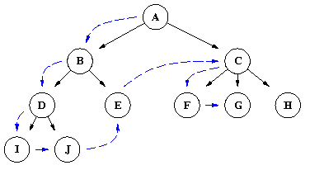
Depth First Seach(BFS)
Definition:
We begin with a starting node or first node, say A, then process the first neighbour of A(B). Then the neighbour of that neighbour of A.
For given graph:
A, B, D, I, J, E, C, F, G, H
DFS Traversal
Edge

Slide 9
Depth First Seach(BFS): Algorithm
Input:
  A graph ‘g’
  An integer ‘start_vertex’
Variables:
  int v; //stores the current vertex
  int stack[MAX]; //to store visited vertices
  adjList *current; // a node in the adjacency list
  int visited[n]; //an array to store visited vertex as 0/1.`
  //1 for visited

Slide 10
Depth First Seach(DFS): Algorithm
Steps
Initialize ‘stack’ to empty
Mark every vertex as not visited by initializing the elements of visited[i]=0 where ‘i’ ranges from 0 to n-1
Mark ‘start_vertex’ as visited
Push ‘start_vertex’ to the stack
While(‘stack’ is not empty)
  Pop from ‘stack’ and store it in ‘v’
  Print ‘v’
  Get the adjacent vertex of ‘v’ and store in ‘current’ i.e. current=g.adjVertex[v];
  While(current != NULL) //Traversing the list till the end
    If (‘current->vertex’ is not yet visited) then
      Mark ‘current->vertex’ as visited i.e. visited[current->vertex]=1
      Push ‘current->vertex’ to ‘stack’
    current=current->next; //Visiting the next node in the list
  End of while //traversing the list has ended
End of while

Slide 11
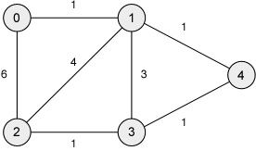
Dijkstra’s Algorithm
Definition:
It is used to find the shortest path from a starting node to a destination node in a weighted graph
Example:
  Shortest path from 0 to 4 is 0 →1 →4

Slide 12
Dijkstra’s Algorithm
Arrays used: Distance List, Previous Vertex List, Current Vertex
All the values in the distance list are set to infinite except vertex 0
All vertex are initially set to not visited i.e. value set to 0
All the values in the previous list is set to 0 to signify undefined
Current vertex = starting node
Mark current vertex as visited
Update distance and previous list based on vertices which can be immediately reached from current vertex
Update the current vertex to the unvisited vertex that can be reached by the shortest path from the starting vertex
Repeat from step 6 until all nodes are visited

Slide 13
Dijkstra’s Algorithm
Requirements
Input: int weights[MAX][MAX], int n, int s, int t
  weights[][] is an array of nxn dimensions
  n: no of vertices in the graph
  s: staring node
  t: target node
Predefined constants:
  INFINITY & MAXNODES: largest possible integers
  MEMBER: 1
  NONMEMBER: 0
Arrays used:
  Distance[ ]:keeps the shortest path known thus far
  Permanent[ ]:contains nodes whose minimal distance from ‘s’ is known
  Previous[ ]: contains nodes that precedes nodes on the shortest path found
Variables:
  current: A node that has been added to Permanent[] most recently
  Shortest_dist: minimum distance from ‘s’ to ‘t’

Slide 14
Dijkstra’s Algorithm
Steps
For(i=0 to n) //Initializations
  permanent[i]=NONMEMBER;
  distance[i]=INFINITY;
permanent[s]=MEMBER;
distance[s]=0;
current=s; //start node
While(current != t)
// as long as target node is not encountered
  smallestDist=INFINITY; //smallest distance from current to its adjacent nodes
  dc=distance[current]; //current distance to this node

Slide 15
Dijkstra’s Algorithm
Steps
  For(i=o to n) //i represents vertices in graph
    If(permanent[i]==NONMEMBER)
      newdist=dc+weight[current][i];
      If(newdist<distance[i])
        distance[i]=newdist;
        previous[i]=current;
      If(distance[i]<smallestDist)
        smallestDist=distance[i];
        k=i;
    End of for
  current=k;
  permanent[current]=MEMBER;
  End of while
shortest_dist=distance[t]; //shortest distance can be returned

